Slide 1
Transaction

Slide 2
A transaction refers to a sequence of one or more operations (such as read, write, update, or delete) performed on the database as a single logical unit of work.
Collections of operations that form a single logical unit of work are called transactions
Operations of Transaction
A user can make different types of requests to access and modify the contents of a database. So, we have different types of operations relating to a transaction. They are discussed as follows:
1) Read(X): A read operation is used to read the value of a particular database element X and stores it in a temporary buffer in the main memory for further actions such as displaying that value.
2) Write(X): A write operation is used to write the value to the database from the buffer in the main memory. For a write operation to be performed, first a read operation is performed to bring its value in buffer, and then some changes are made to it,

Slide 3
3) Commit: This operation in transactions is used to maintain integrity in the database. Due to some failure of power, hardware, or software, etc., a transaction might get interrupted before all its operations are completed. This may cause ambiguity in the database, i.e. it might get inconsistent before and after the transaction.
Once the transaction is committed, the changes to the database are permanent, and the transaction is considered successful.
4) Rollback: If an error occurs, the Rollback operation undoes all the changes made by the transaction, reverting the database to its last consistent state. In simple words, it can be said that a rollback operation does undo the operations of transactions that were performed before its interruption to achieve a safe state of the database and avoid any kind of ambiguity or inconsistency.

Slide 4
Properties of Transaction
As transactions deal with accessing and modifying the contents of the database, they must have some basic properties which help maintain the consistency and integrity of the database before and after the transaction.
Transactions follow 4 properties, namely, Atomicity, Consistency, Isolation, and Durability.
Generally, these are referred to as ACID properties of transactions in DBMS.

Slide 5
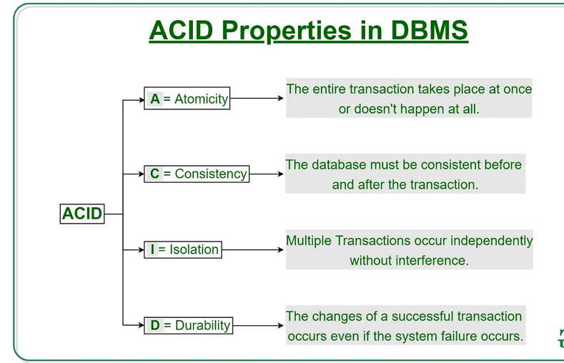

Slide 6
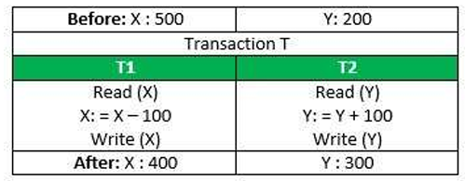
1) Atomicity
This property ensures that either all operations of a transaction are executed or it is aborted. In any case, a transaction can never be completed partially.
Each transaction is treated as a single unit (like an atom).
Atomicity is achieved through commit and rollback operations, i.e. changes are made to the database only if all operations related to a transaction are completed, and if it gets interrupted, any changes made are rolled back using rollback operation to bring the database to its last saved state.

Slide 7
2) Consistency
This property of a transaction keeps the database consistent before and after a transaction is completed.
Example:
If an account balance before the transaction is 1000, after a successful transaction of 200, the new balance should be 800, ensuring the database stays in a consistent state.
Example:
Total before T occurs = 500 + 200 = 700.
Total after T occurs = 400 + 300 = 700.
Therefore, database is consistent. Inconsistency occurs in case T1 completes but T2 fails. As a result T is incomplete.

Slide 8
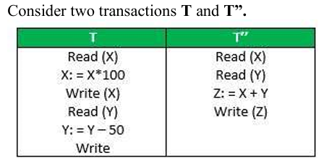
3) Isolation
This property states that two transactions must not interfere with each other, i.e. if a transaction uses some data for its execution, then any other transaction can not concurrently access that data until the first transaction has completed. It ensures that the integrity of the database is maintained and we don't get any ambiguous values. Thus, any two transactions are isolated from each other.

Slide 9
4) Durability
The database should be durable enough to hold all its latest updates even if the system fails or restarts. These updates now become permanent and are stored in non-volatile memory.
The effects of the transaction, thus, are never lost.

Slide 10
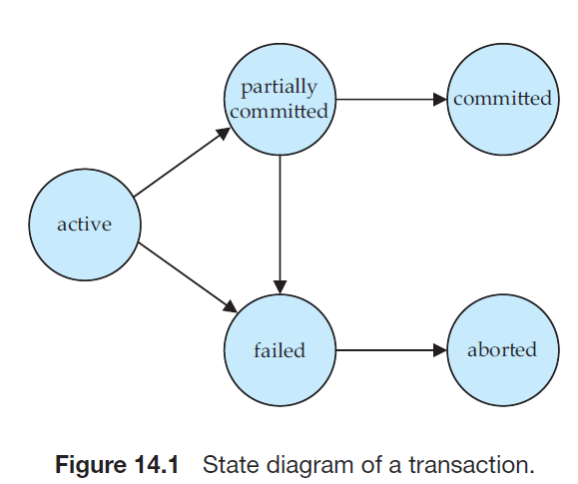
Transaction State Diagrams

Slide 11
Active State:
When the operations of a transaction are running then the transaction is said to be active state.
It is the first stage of any transaction when it has begun to execute. The execution of the transaction takes place in this state.
Operations such as insertion, deletion, or updation are performed during this state.
During this state, the data records are under manipulation and they are not saved to the database, rather they remain somewhere in a buffer in the main memory.

Slide 12
Partially Committed:
If all the read and write operations are performed without any error then it progresses to the partially committed state, if somehow any operation fails, then it goes to a state known as failed state.
The transaction has finished its final operation, but the changes are still not saved to the database.
After completing all read and write operations, the modifications are initially stored in main memory or a local buffer.
Failed State:
If any of the transaction-related operations cause an error during the active or partially committed state, further execution of the transaction is stopped and it is brought into a failed state.

Slide 13
Aborted State:
If a transaction reaches the failed state due to a failed check, the database recovery system will attempt to restore it to a consistent state.
If recovery is not possible, the transaction is either rolled back or cancelled to ensure the database remains consistent.
In the aborted state, the DBMS recovery system performs one of two actions:
Kill the transaction: The system terminates the transaction to prevent it from affecting other operations.
Restart the transaction: After making necessary adjustments, the system reverts the transaction to an active state and attempts to continue its execution.

Slide 14
Committed:
This state of transaction is achieved when all the transaction-related operations have been executed successfully along with the Commit operation, i.e. data is saved into the database after the required manipulations in this state. This marks the successful completion of a transaction.

Slide 15
Transaction Schedule
A series of operations from one transaction to another transaction is known as a schedule.
Scheduling is the technique of preserving the order of the operations from one transaction to another while executing such concurrent transactions.

Slide 16
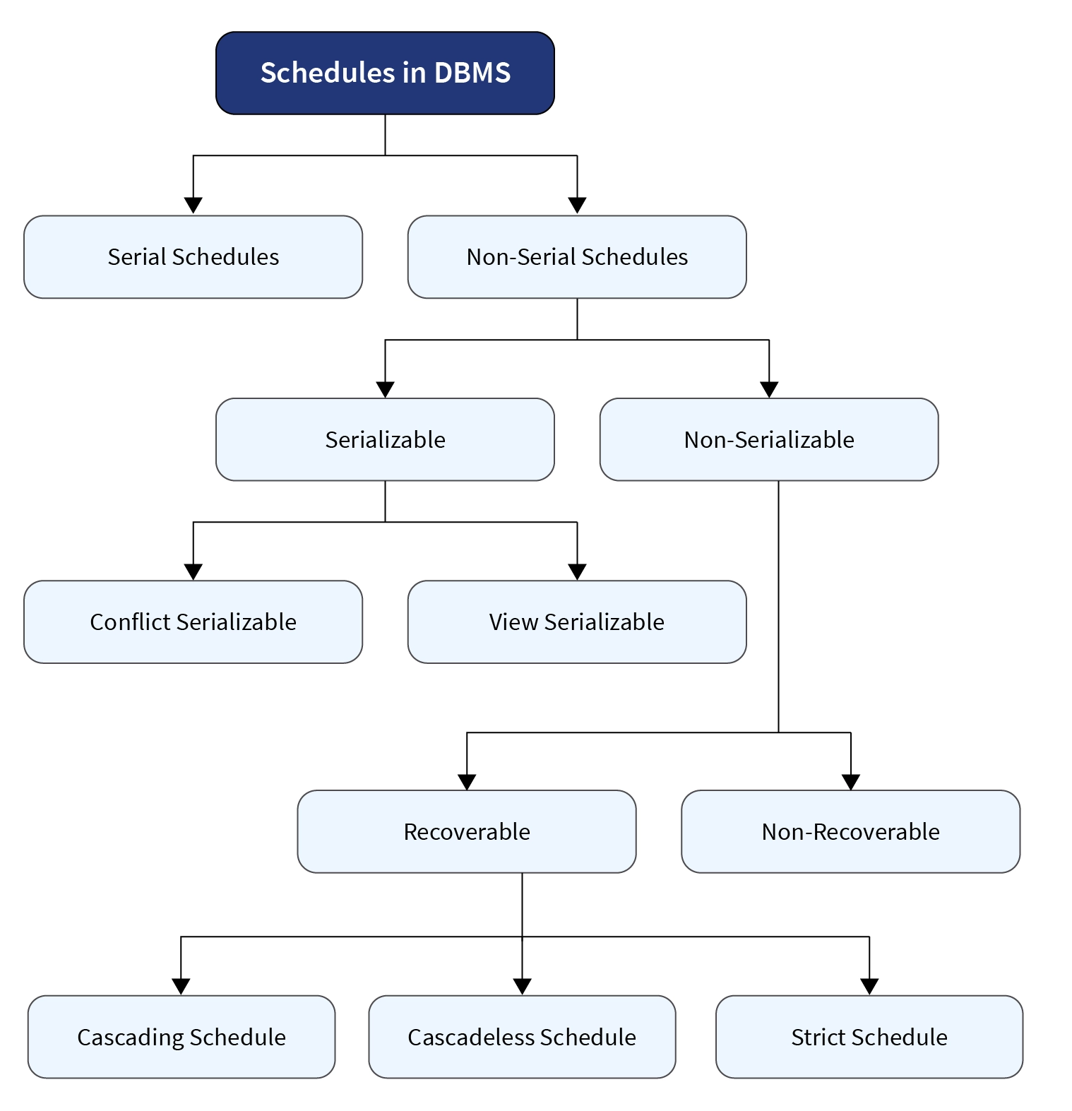

Slide 17
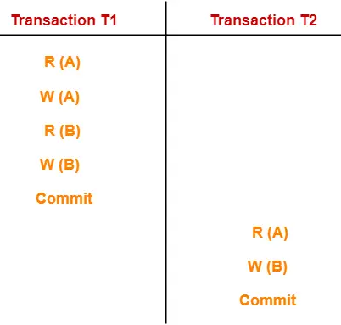
Serial Schedules:
In serial schedules,
All the transactions are executed serially, one after the other.
When one transaction executes, no other transaction is allowed to execute.
Serial Schedules are always recoverable, cascadeless, strict, and consistent. A serial schedule always gives the correct result.
In this schedule, there are two transactions
T1 and T2 executing serially one after the other.
Transaction T1 executes first. After T1 completes
its execution, transaction T2 executes. So, this
schedule is an example of a Serial Schedule.

Slide 18
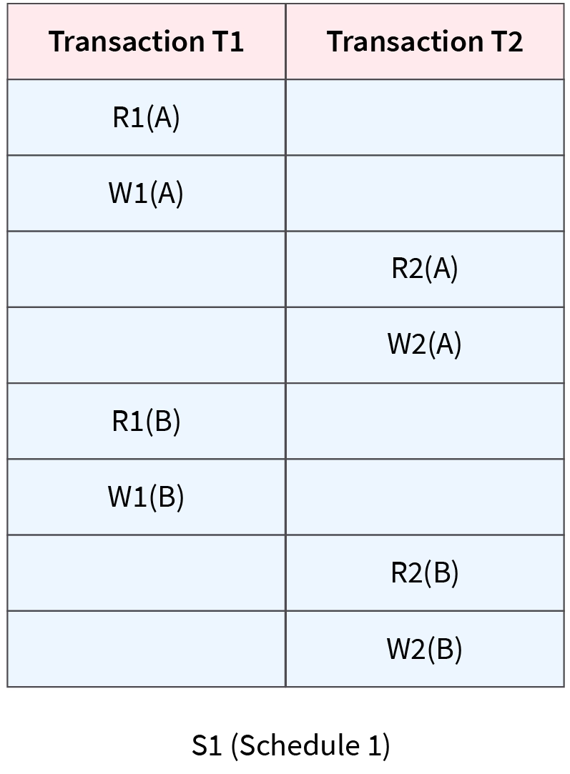
Non-Serial / Concurrent Schedules:
In non-serial schedules,
Multiple transactions execute concurrently.
Operations of all the transactions are interleaved or mixed.
In the non-serial schedule, the other transaction proceeds without waiting for the previous transaction to complete.
Non-serial schedules are NOT always recoverable, Cascadeless, strict, and consistent.
Non-serial schedules are further categorized into serializable and non-serializable schedules.

Slide 19
Serializability in DBMS
A non-serial schedule of n transactions is said to be a serializable schedule, if it is equivalent to the serial Schedule of those n transactions. A serial schedule does not allow concurrency; only one transaction executes at a time, and the other starts when the already running transaction is finished.
Types of Serializability:
Conflict Serializability
View Serializability

Slide 20
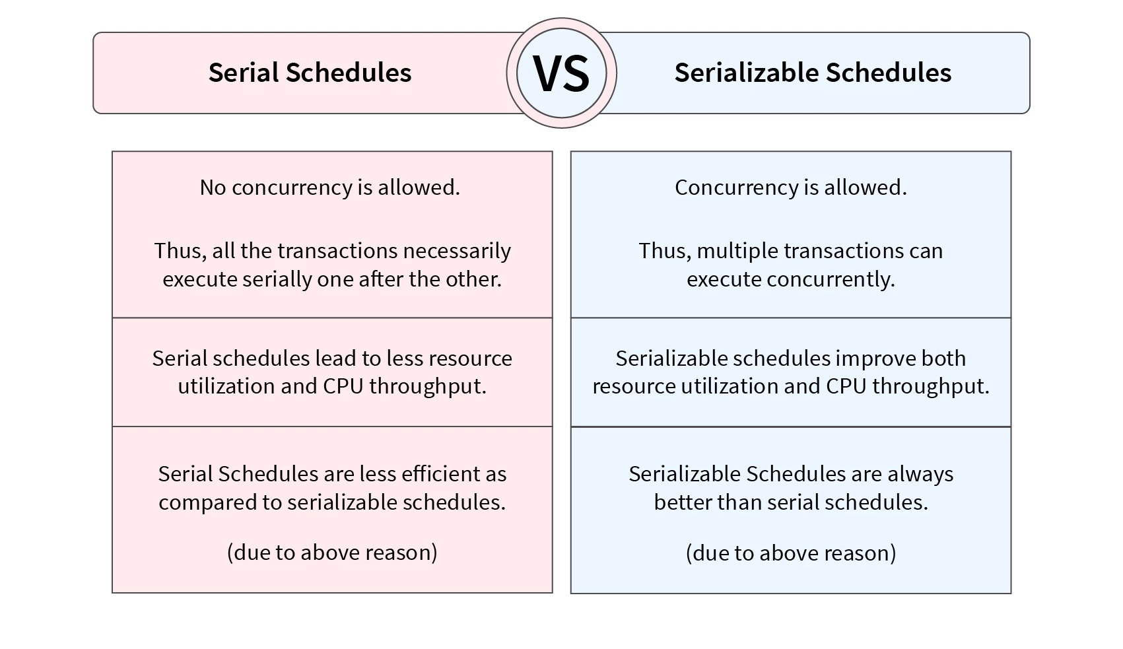

Slide 21
Conflict Serializability
Conflict Serializability checks if a non-serial schedule is conflict serializable or not. A non-serial schedule is conflict-serializable if it can convert into a serial schedule by swapping its non-conflicting operations.
Conflicting Operations:
A pair of operations are said to be conflicting operations if they follow the set of conditions given below:
Each operation is a part of different transactions.
Both operations are performed on the same data item.
One of the performed must be a write operation.

Slide 22
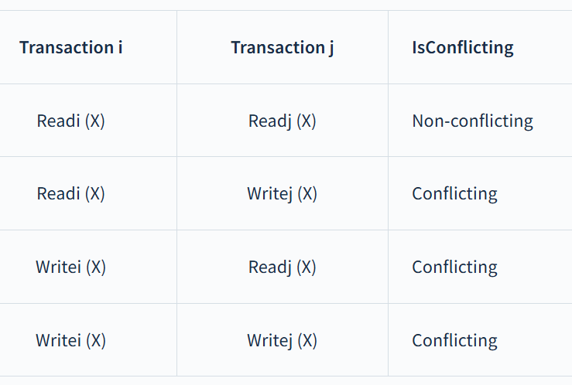
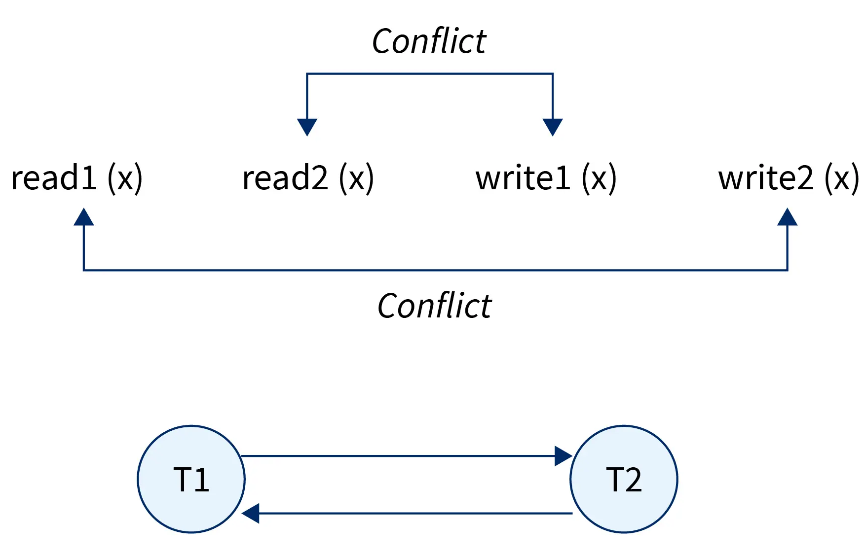
Let's consider two different transactions, Ti​ and Tj. Then, considering the above conditions, the following table follows:

Slide 23
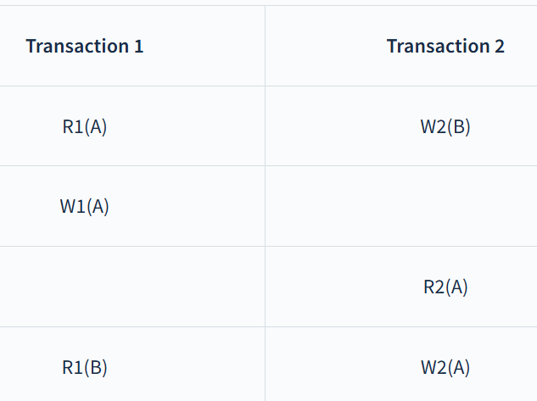
Example:
In the above schedule, we can notice that:
W1(A) and R2(A) are part of different transactions. Both apply to the same data item, i.e., A. W1(A) is a write operation.
W1(A) and R2(A) are conflicting operations as they satisfy all the above conditions.
W1(A) and W2(B) are non-conflicting operations as they work on different data items and thus do not satisfy all the given conditions.
R1(A) and R2(A) are non-conflicting operations as neither of them is a write operation and thus does not satisfy the third condition.
W1(A) and R1(A) are non-conflicting as they belong to the same transactions and thus do not satisfy the first condition.

Slide 24
Precedence Graph
A precedence graph, also known as serialization graph or conflict graph, is used for testing Conflict Serializability of a schedule in the condition that forms the setting of concurrency control in databases.
It is always a directed acyclic graph.
This graph consists of a pair G = (V, E), where V is a set of vertices and E is a set of edges. The set of vertices consists of all the transactions participating in the schedule.
The precedence graph is one of the most important tools in database management. It is used to test the conflict serialization of transaction schedules. The graph identifies cycles in the execution sequence of transactions to determine if the schedule is conflict serializable.

Slide 25
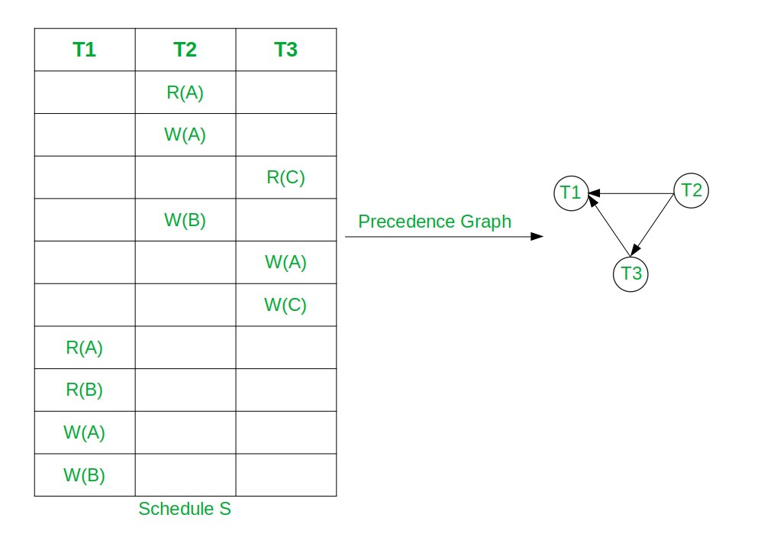
Let, the Conflict Serial Schedule be S: R2(A) W2(A) R3(C) W2(B) W3(A) W3(C) R1(A) R2(B) W1(A) W2(B)
Here node T2 has indegree 0.
So, select T2 and remove T2 and all edges connecting from it.
Now T3 has indegree 0. So, select T3 and remove the edge T3→T1.
At the end select T3. So the topological Sorting is T2, T3, T1.
Hence, the equivalent serial schedule of given conflict serializable schedule is T2→T3→T1, i.e.,
S2: R2(A) W2(A) W2(B) R3(C) W3(A) W3(C) R1(A) R2(B) W1(A) W1(B).

Slide 26
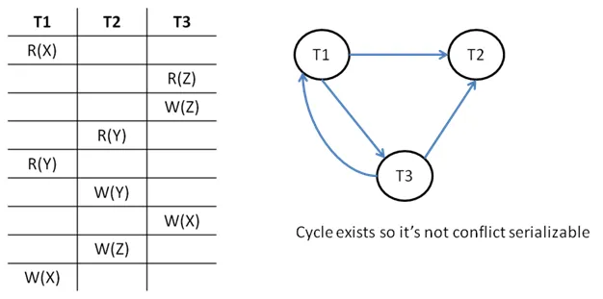

Slide 27
Non-Serializability
A non-serial schedule that is not serializable is called a non-serializable schedule.
Non-serializable schedules may/may not be consistent or recoverable.
Non-serializable Schedule is divided into types:
Recoverable Schedule
Non-recoverable Schedule

Slide 28
Recoverable Schedule
Recoverability refers to the ability of a system to restore data to its original, consistent state after a failure or interruption.
Recoverability involves mechanisms such as transaction logging, checkpointing, and transaction rollback to ensure that, in the event of a system crash or failure, the database can be restored to a consistent state without losing any committed transactions.
It ensures that data remains durable and consistent despite unforeseen events, maintaining the integrity and reliability of the database system.
A schedule is recoverable if each transaction commits only after all the transactions from which it has read have committed. In other words, if some transaction Ty reads a value that has been updated/written by some other transaction Tx, then the commit of Ty must occur after the commit of Tx.

Slide 29
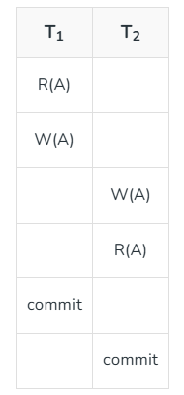
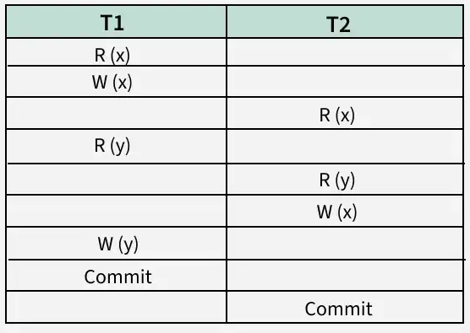
The schedules shown above are Recoverable since T1 commits before T2, which makes the value read by T2 correct.

Slide 30
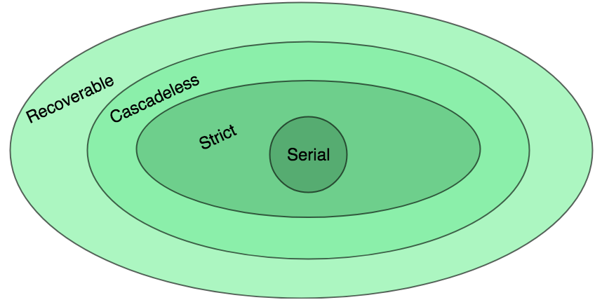
Recoverable schedules are further categorized into 3 types:
Cascading Schedule
Cascadeless Schedule
Strict Schedule

Slide 31
Cascading Schedule
If in a schedule, several other dependent transactions are forced to rollback/abort because of the failure of one transaction, then such a schedule is called a Cascading Schedule or Cascading Rollback or Cascading Abort. It simply leads to the wastage of CPU time.
Cascading refers to a situation where the failure of one transaction causes a chain reaction of rollbacks in other dependent transactions.
The phenomenon, in which a single transaction failure leads to a series of transaction rollbacks, is called cascading rollback.
This happens because the dependent transactions rely on data or changes made by the failed transaction. If the changes are rolled back, the dependent transactions also need to roll back to maintain consistency.

Slide 32
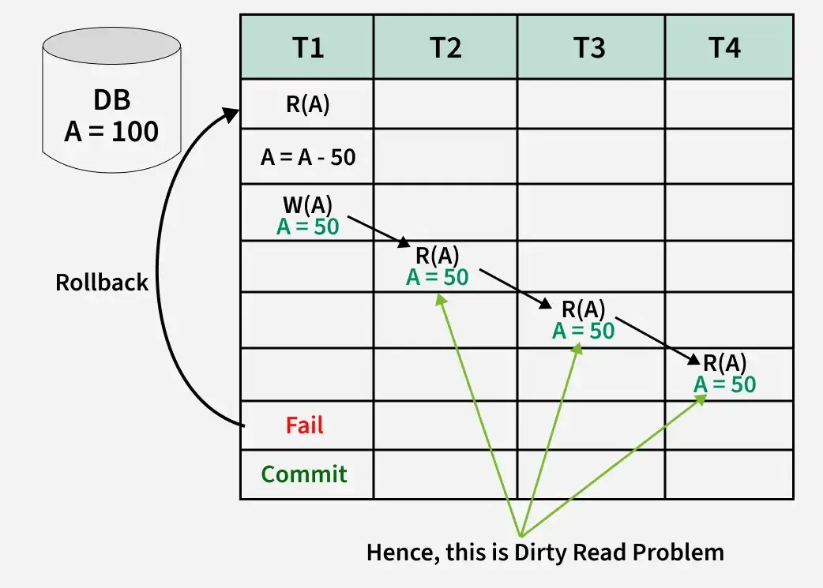
Cascading occurs when a transaction reads uncommitted data (also called dirty data) from another transaction.
If the first transaction fails or is rolled back, the data read by the second transaction becomes invalid, forcing the rollback of the dependent transaction as well.
Here,
Transaction T2 depends on transaction T1.
Transaction T3 depends on transaction T2.
Transaction T4 depends on transaction T3.
In this schedule,
The failure of T1 causes the transaction T2 to rollback.
The rollback of T2 causes the transaction T3 to rollback.
The rollback of 13 causes the transaction T4 to rollback.
When a Transaction reads data from an uncommitted write in another transaction, then it is known as Dirty Read.
If that writing transaction failed, the written data may be updated again. Therefore, this causes the Dirty Read Problem.

Slide 33
Cascadeless Schedule
A cascadeless schedule is a type of transaction schedule in a database where no transaction is allowed to read data that has been modified by another transaction until that transaction has either committed or aborted.
It allows only committed read operations
Thus avoids cascading rollback and saves CPU time
However, it allows uncommitted write operations.
This ensures that transactions only work with stable, reliable data, avoiding problems caused by uncommitted changes.

Slide 34
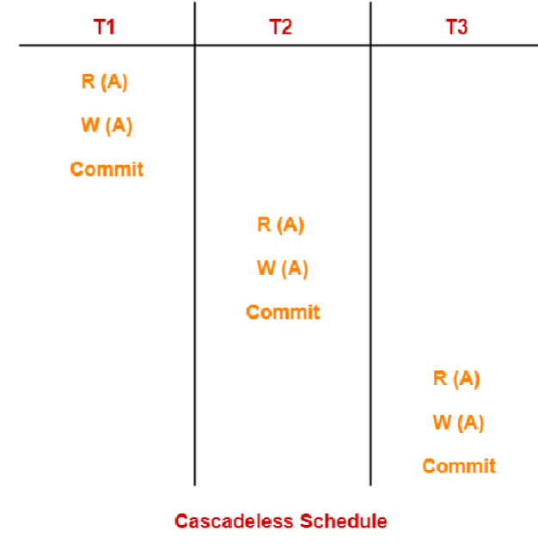
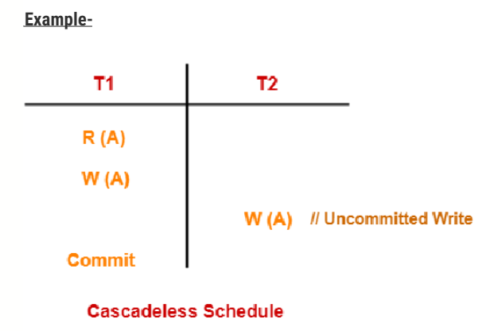
Write-Write (W-W) Conflicts: While cascadeless schedules prevent Read-Write (R-W) conflicts (dirty reads), they do not prevent Write-Write conflicts. A transaction might overwrite data written by another uncommitted transaction (a lost update).

Slide 35
How a Cascadeless Schedule Works?
When a transaction modifies a data item, other transactions are restricted from accessing (reading) that data until the first transaction has finalized its changes.
This means the data is only accessible after the transaction has either:
Committed: Confirmed and saved its changes permanently.
Aborted: Rolled back its changes, returning the data to its previous state.

Slide 36
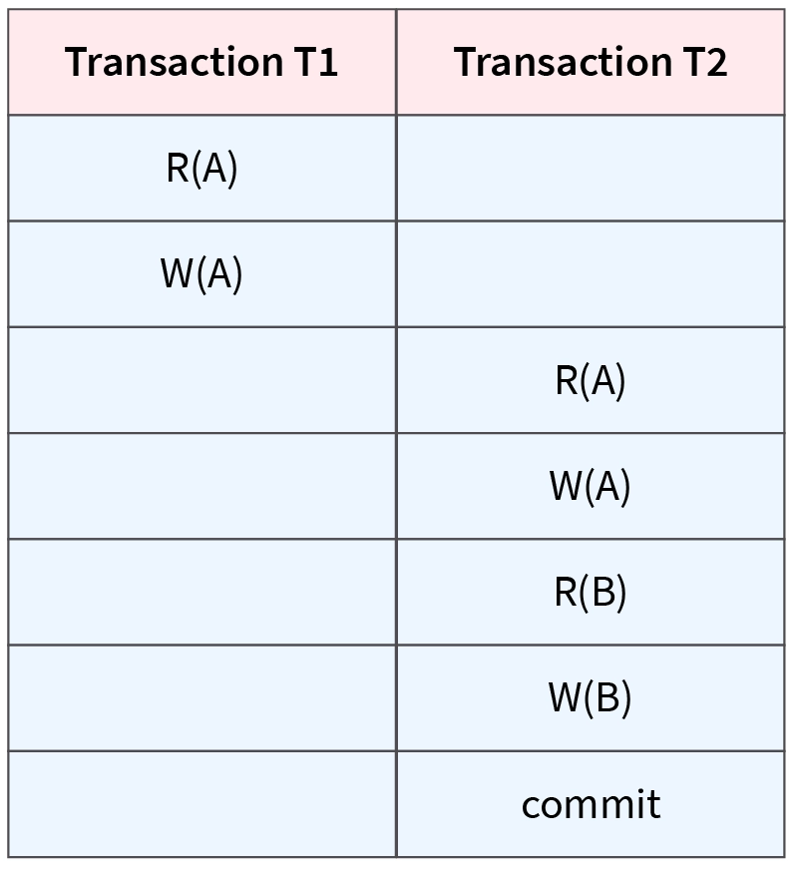
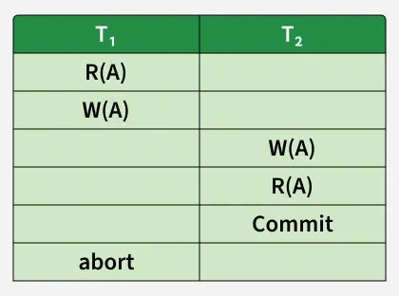
Non-recoverable Schedule
If a transaction reads the value of an operation from an uncommitted transaction and commits before the transaction from where it has read the value, then such a schedule is called a Non-Recoverable schedule.
A non-recoverable schedule means when there is a system failure, we may not be able to recover to a consistent database state.

